Slide 1
SAMHSA: Priorities and Cross-Cutting Principles
Miriam Delphin-Rittmon, PhD
Assistant Secretary for Mental Health and Substance Use
Substance Abuse and Mental Health Services Administration
U.S. Department of Health and Human Services
National Council for Mental Wellbeing
Virtual Board Meeting
August 19, 2021
2:30 pm
Notes:
Presentation title slide
Do not change colors
Add title where designated

Slide 2
Setting the nation’s behavioral health agenda
Goal
Provide leadership and resources to advance mental and substance use disorder prevention, intervention, treatment, and recovery services.
Outcome
Decrease impact of substance misuse and mental illness on America’s communities to improve individual, community, and public health.
Cross-cutting strategy
Enhance our focus on data and equity to improve access to, use of, and outcomes from SAMHSA-funded services.

Slide 3
SAMHSA At-A-Glance
Mission
Established in 1992 to reduce the impact of substance abuse and mental illness on America's communities
Priorities & principles
SAMHSA has identified five core near-term priorities, as well several cross-cutting principles
Staff & structure
Staff currently includes 664 FTEs, including 183 vacancies. The agency includes 9 offices/centers, 10 regional administrators, and several national advisory boards
Budget
SAMHSA FY 2021 American Rescue Plan Act: $3.56B
FY22 budget request: $9.7B

Slide 4
SAMHSA Priorities and Cross-Cutting Principles
Cross-cutting principles
2. Enhancing access to suicide prevention & crisis care
1. Preventing overdose
Equity
3. Promoting children & youth behavioral health
SAMHSA priorities
Workforce
5. Using performance measures, data, and evaluation
4. Integrating primary and behavioral healthcare
Financing

Slide 5
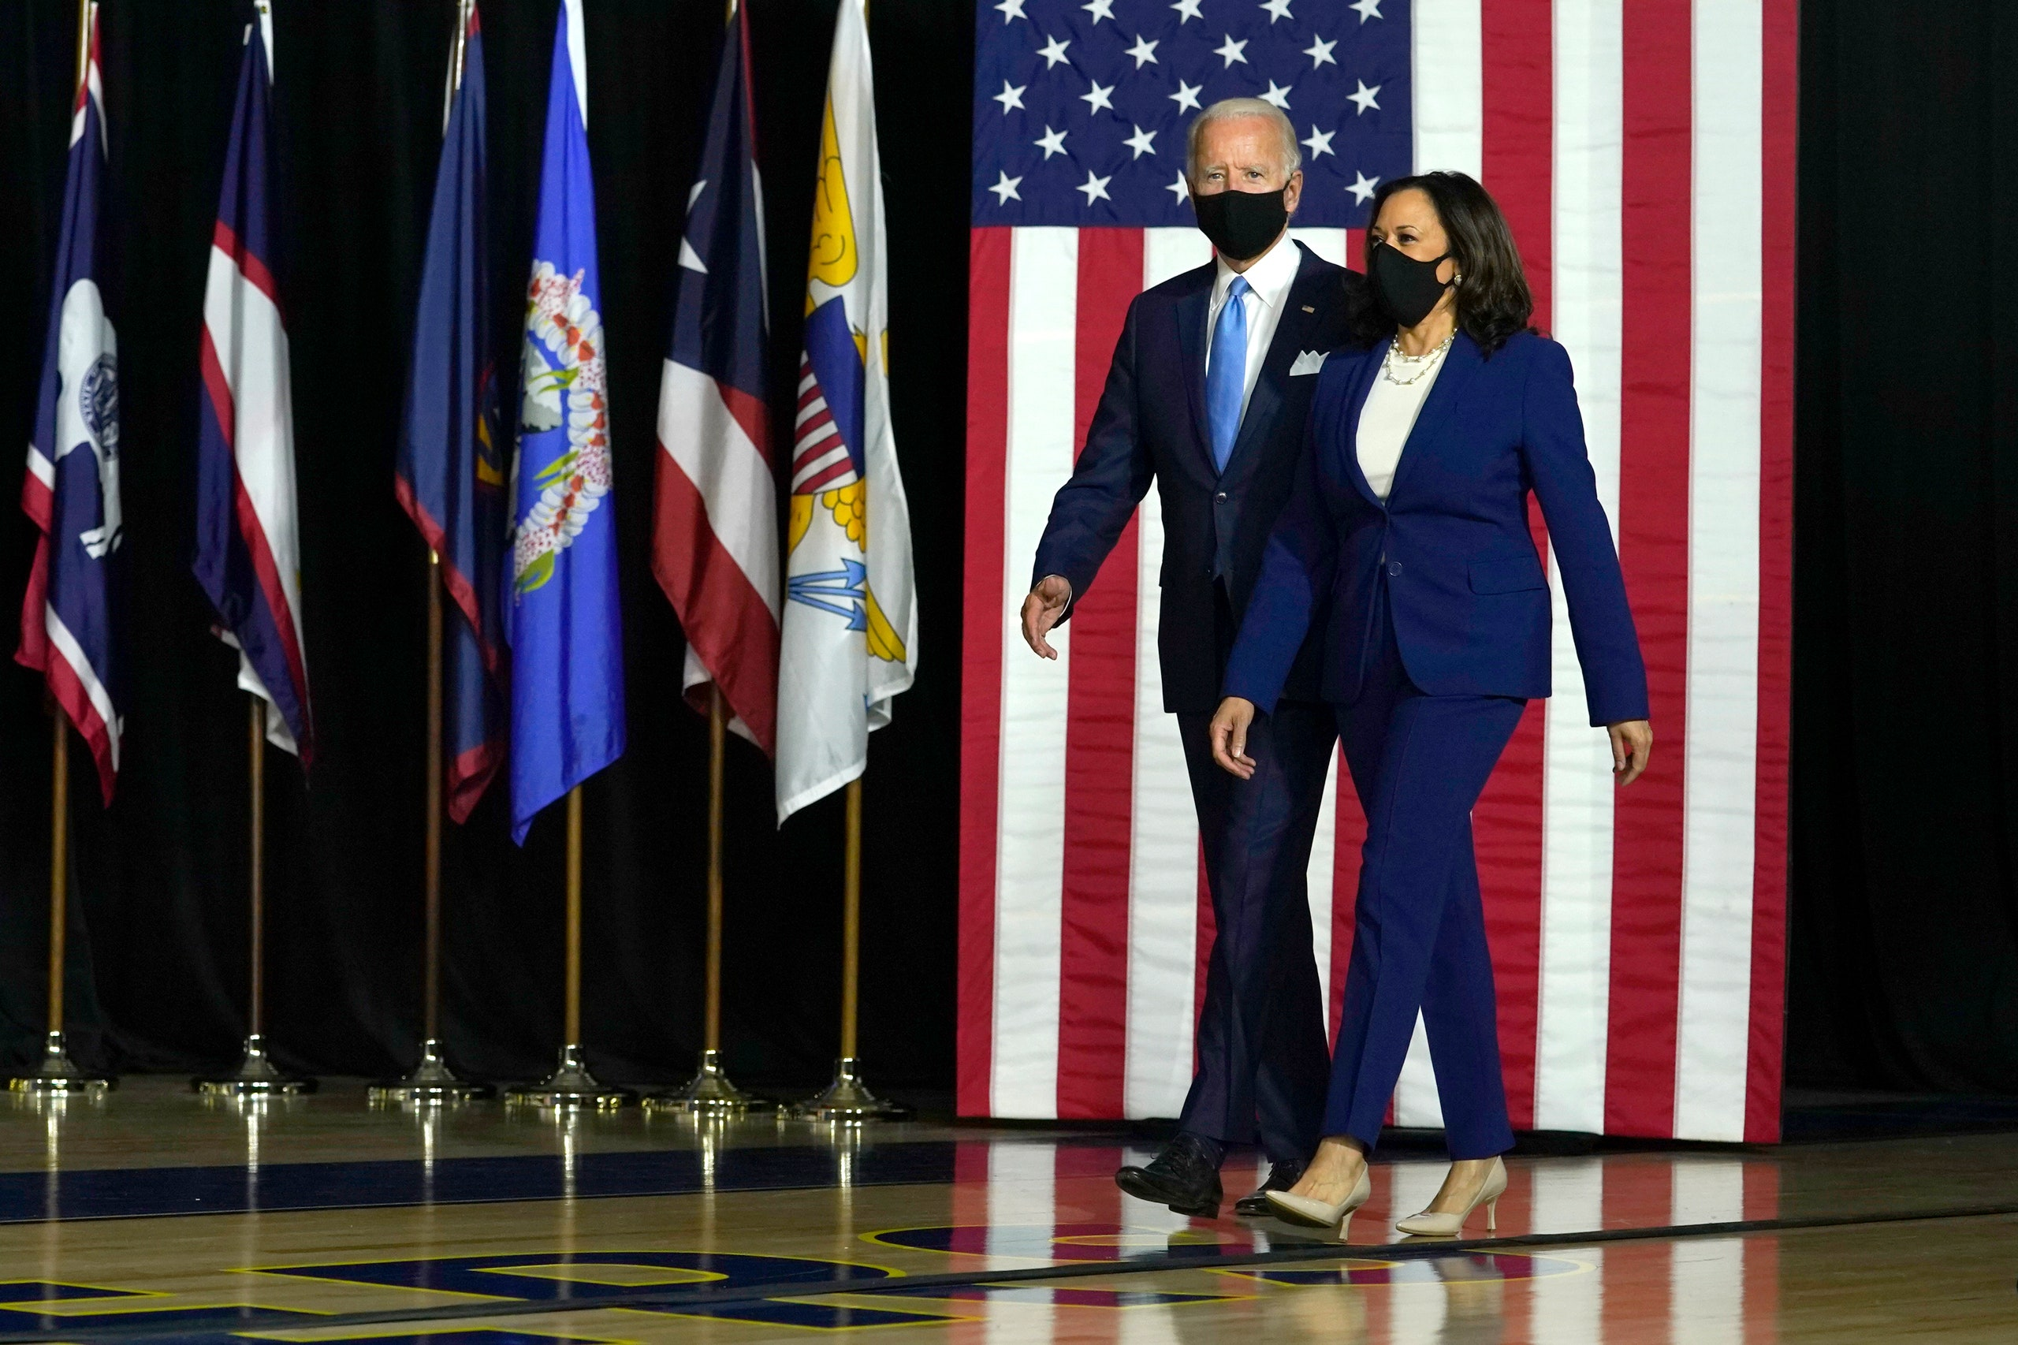
SAMHSA and the Biden-Harris Administration
Immediate Priorities
COVID-19
Climate
Racial Equity
Economy
Health Care
Immigration
Restoring America’s Global Standing

Slide 6
FY 2021 COVID Supplemental Funding: $4.25B
Grant/Program | Funding
Certified Community Behavioral Health Clinics | $600,000,000
Suicide Prevention | $50,000,000
Emergency Response | $240,000,000
Community Mental Health Service Block Grant | $1,650,000,000
Substance Abuse Prevention and Treatment Block Grant | $1,650,000,000
Project AWARE (Advancing Wellness and Resiliency in Education) | $50,000,000
National Child Traumatic Stress Network | $10,000,000
SAMHSA FY 2021 Appropriation: +$6,017,000,000

Slide 7
SAMHSA FY 2021 American Rescue Plan Act: $3.56B
Grant/Program | Funding
Block Grants for Community Mental Health Services | $1,500,000,000
Block Grants for Prevention and Treatment of Substance Abuse | $1,500,000,000
Community-Based Funding For Local Substance Use Disorder Services | $30,000,000
Community-Based Funding for Local Behavioral Health Needs | $50,000,000
National Traumatic Stress Network | $10,000,000
Project AWARE | $30,000,000
Youth Suicide Prevention (GLS State, Tribe, and campus) | $20,000,000
Certified Community Behavioral Health Clinics | $420,000,000

Slide 8
SAMHSA FY 2022 Budget Request: $9.7B
Appropriation | Budget Request | Program Highlights
Mental Health | $2,936,528,000 | Community Mental Health Services Block Grant: $1.6B Certified Community Behavioral Health Clinics: $375M Suicide Prevention Programs: $179.7M Project AWARE: $155.5M National Child Traumatic Stress Network: $81.9M
Substance Use Prevention | $216,667,000 | Strategic Prevention Framework: $126.7M
Substance Use Treatment | $6,408,943,000 | Substance Abuse Prevention and Treatment Block Grant: $3.5B State Opioid Response Grants: $2.3B Targeted Capacity Expansion: $147.9M Criminal Justice Activities: $124.4M First Responders Comprehensive Addiction and Recovery Act: $63M
Health Surveillance and Program Support | $171,873,000 | Program Support: $83.3M Drug Abuse Warning Network: $15M

Slide 9
SAMHSA’s Programs Aligned to Emerging Priorities
1. Preventing overdose
2. Promoting children and youth BH
3. Integrating primary and behavioral health care
4. Using performance measures, data and evaluation
5. Enhancing access to suicide prevention & crisis care
Center for Substance Abuse Treatment
SBIRT
State Opioid Response Program
Certification of Opioid Treatment Programs
Center for Mental Health Services
988
Certified Community BH Clinics Expansion Grant
Project AWARE
Center for Substance Use Prevention
STOP Act grants
Harm reduction
Overdose prevention strategy
Center for Behavioral Health Statistics and Quality
Disparity impact statement (in partnership with OBHE)
National population surveys (e.g., NSDUH, BHSIS)
Source: SAMHSA estimates

Slide 10
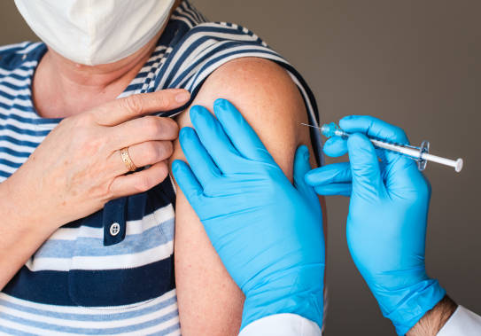
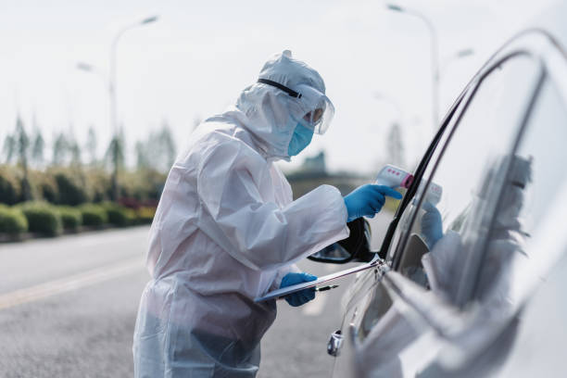
A Commitment to Behavioral Health

