Slide 1
Residential Programs
Rate Increases
Office of Financial Management

Slide 2
Rate Increases – Community Residence
American Rescue Plan Act (ARPA) - time limited
Workforce Recruitment and Retention: 20.0% (eff. 10/1/21 - 3/31/22)
HCBS: 9.6% (eff. 10/14/21 - 3/31/22)
Ongoing program investment
4.8% minimum increase (eff. 4/1/22)
Cost of Living Adjustment - permanent
5.4% (eff. 4/1/22)
Notes:
ARPA/$65M investments:
Convergence of apartment models (all apartment staffing/rates now using intensive supportive model)
Salary investment to make current original BLS salary used in 4/1/21 model redesign
Additional OTPS investment
Eliminates enhanced apartment treatment
Reduced number of conversion payments based on a floor of 10% for revenue increase by provider region

Slide 3
Rate Increases – Single Room Occupancy (SRO)
Region | Bed Type | 4/1/21 Net Rate | 4/1/2022 COLA 5.4% | 4/1/2022 Stipend Increase | 4/1/2022 Net Rate
Central | CR SRO | $ 16,050 | $ 867 | $ 900 | $ 17,817
Hudson River (Upper) | CR SRO | $ 16,050 | $ 867 | $ 900 | $ 17,817
Hudson River (Lower) | CR SRO | $ 17,902 | $ 967 | $ 1,000 | $ 19,869
Long Island | CR SRO | $ 18,005 | $ 972 | $ 1,000 | $ 19,977
NYC | CR SRO | $ 19,410 | $ 1,048 | $ 1,000 | $ 21,458
Western | CR SRO | $ 16,050 | $ 867 | $ 900 | $ 17,817
Central | SP SRO | $ 15,804 | $ 853 | $ 900 | $ 17,557
Hudson River (Upper) | SP SRO | $ 15,804 | $ 853 | $ 900 | $ 17,557
Hudson River (Lower) | SP SRO | $ 17,800 | $ 961 | $ 1,000 | $ 19,761
Long Island | SP SRO | $ 17,903 | $ 967 | $ 1,000 | $ 19,870
NYC | SP SRO | $ 19,264 | $ 1,040 | $ 1,000 | $ 21,304
Western | SP SRO | $ 15,804 | $ 853 | $ 900 | $ 17,557
Notes:
ARPA/$65M investments:
Convergence of apartment models (all apartment staffing/rates now using intensive supportive model)
Salary investment to make current original BLS salary used in 4/1/21 model redesign
Additional OTPS investment
Eliminates enhanced apartment treatment
Reduced number of conversion payments based on a floor of 10% for revenue increase by provider region

Slide 4
Rate Increases – Supported Housing
5.4% COLA (eff. 4/1/22) - $15.5M gross increase
$449 - $1,015 per bed increases
Stipend Increase (eff. 4/1/22) - $23.5M gross increase
State Plan Amendment (SPA) – voluntary participation
$600 Upstate and $1,200 Downstate per bed increase for all participating providers to start in 2022
Notes:
ARPA/$65M investments:
Convergence of apartment models (all apartment staffing/rates now using intensive supportive model)
Salary investment to make current original BLS salary used in 4/1/21 model redesign
Additional OTPS investment
Eliminates enhanced apartment treatment
Reduced number of conversion payments based on a floor of 10% for revenue increase by provider region

Slide 5
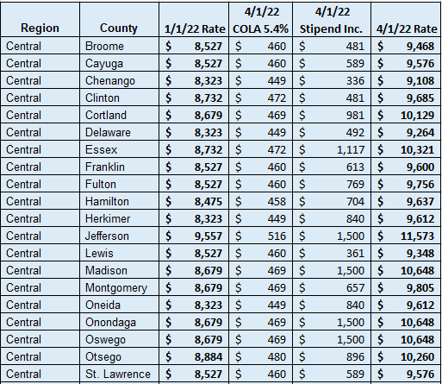
Rate Increases – Supported Housing (SH)
Notes:
ARPA/$65M investments:
Convergence of apartment models (all apartment staffing/rates now using intensive supportive model)
Salary investment to make current original BLS salary used in 4/1/21 model redesign
Additional OTPS investment
Eliminates enhanced apartment treatment
Reduced number of conversion payments based on a floor of 10% for revenue increase by provider region

Slide 6
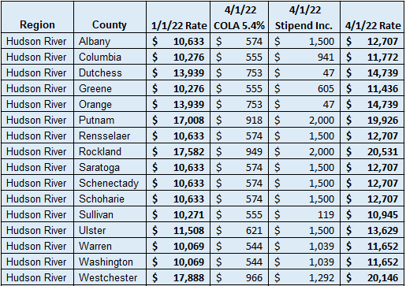
Rate Increases – Supported Housing (SH)
Notes:
ARPA/$65M investments:
Convergence of apartment models (all apartment staffing/rates now using intensive supportive model)
Salary investment to make current original BLS salary used in 4/1/21 model redesign
Additional OTPS investment
Eliminates enhanced apartment treatment
Reduced number of conversion payments based on a floor of 10% for revenue increase by provider region

Slide 7
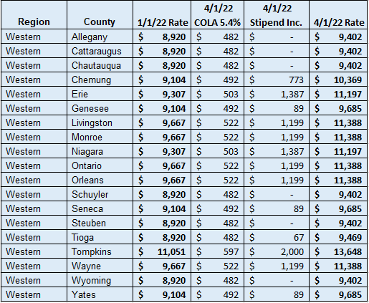
Rate Increases – Supported Housing (SH)
Notes:
ARPA/$65M investments:
Convergence of apartment models (all apartment staffing/rates now using intensive supportive model)
Salary investment to make current original BLS salary used in 4/1/21 model redesign
Additional OTPS investment
Eliminates enhanced apartment treatment
Reduced number of conversion payments based on a floor of 10% for revenue increase by provider region

Slide 8
Rate Increases – Supported Housing (SH)
Notes:
ARPA/$65M investments:
Convergence of apartment models (all apartment staffing/rates now using intensive supportive model)
Salary investment to make current original BLS salary used in 4/1/21 model redesign
Additional OTPS investment
Eliminates enhanced apartment treatment
Reduced number of conversion payments based on a floor of 10% for revenue increase by provider region

Slide 9
Article 31 Community Program
Rate Increases
Office of Financial Management

Slide 10
5.4% Cost of Living Adjustment (COLA)
Article VII Bills- Health and Mental Hygiene (HMH) (S8007-C/A9007-C)
Eligible programs and services:
OMH, OASAS and OPWDD community programs
Certain other ‘human services programs’ funded, licensed, or certified by DOH, OTDA, OCFS, and SOFA
Effective on April 1, 2022

Slide 11
Rate Increases – Mental Health Outpatient Treatment and Rehabilitative Services
American Rescue Plan Act (ARPA) - time limited
Workforce Recruitment and Retention: 11.5% (eff. 2/1/22 - 9/30/22)
HCBS: 5.0% (eff. 2/1/22 - 3/31/23)
Ongoing program investment: 5.0% (eff. 2/1/22)
Cost of Living Adjustment: 5.4% (eff. 4/1/22)

Slide 12
Rate Increases – Personalized Recovery Oriented Services (PROS)
American Rescue Plan Act (ARPA) - time limited
Workforce Recruitment and Retention: 13.1% (eff. 10/14/21 - 3/31/22)
HCBS: 22.3% (eff. 10/14/21 - 3/31/22)
Ongoing program investment: 10.3% (eff. 4/1/22)
Cost of Living Adjustment: 5.4% (eff. 4/1/22)

Slide 13
Rate Increases – Assertive Community Treatment (ACT)
American Rescue Plan Act (ARPA) - time limited
Workforce Recruitment and Retention: 8.5% (eff. 10/7/21 - 3/31/22)
HCBS: 10.4% (eff. 10/14/21 - 3/31/22)
Ongoing program investment: 5.0% (eff. 4/1/22)
Cost of Living Adjustment: 5.4% (eff. 4/1/22)

Slide 14
Rate Increases – Community Residence
American Rescue Plan Act (ARPA) - time limited
Workforce Recruitment and Retention: 20.0% (eff. 10/1/21 - 3/31/22)
HCBS: 9.6% (eff. 10/14/21 - 3/31/22)
Ongoing program investment
4.8% minimum increase (eff. 4/1/22)
Cost of Living Adjustment - permanent
5.4% (eff. 4/1/22)
Notes:
ARPA/$65M investments:
Convergence of apartment models (all apartment staffing/rates now using intensive supportive model)
Salary investment to make current original BLS salary used in 4/1/21 model redesign
Additional OTPS investment
Eliminates enhanced apartment treatment
Reduced number of conversion payments based on a floor of 10% for revenue increase by provider region

Slide 15
Rate Increases – Day Treatment, Continuing Day Treatment and Partial Hospitalization Services
Cost of Living Adjustment: 5.4% (eff. 4/1/22)
Ongoing program investment – permanent
5% increase (eff. 7/1/22)

Slide 16
OMH Article 28 Rate Increases
& Investments
Office of Financial Management

Slide 17
Rate Increases - Medicaid FFS Inpatient Psychiatric
July 1, 2018 (SPA 18-59) Children’s inpatient rates increased 25% adjustment factor from 1.0872 to 1.3597
October 1, 2018 (SPA 18-66) @ 5.22% base rate $676.21
August 1, 2021 (SPA 21-18) @ 9.86% base rate $742.68
January 1, 2022 (SPA 22-05) Expanded rural definition
April 1, 2022
(SPA 22-47) @ 27.94% proposed $950.43
Restore 1.5% Budget cut from prior year
Across the Board increase of Medicaid rates by 1%

Slide 18
Comprehensive Psychiatric Emergency Program (CPEP) Rate Increases
CPEP Rate Increases (New rates for Triage and Referral Visits, Full Emergency Visits and Extended Observation Beds) planned for 7/1/2022 effective date
FPN increase statewide CPEP Medicaid spending by $20M
More details with revised fees to come in shortly with State Plan submission
State Aid for CPEP Mobile Crisis Start-Up and Expansion
$500K annual for two years; July 1, 2022 through June 30, 2024.
Support for start-up, adding Peers and expansion of mobile crisis.
Future reinvestment of 3-year eFMAP @ 85% for mobile crisis.

Slide 19
$9M Investment Recruitment and Retention of Psychiatrists and Psychiatric Nurse Practitioners
OMH is developing a loan repayment program for Psychiatrists and Nurse Practitioners to assist with recruitment and retention in Article 28 inpatient, CPEP and community settings (ACT, Clinic, etc.)
OMH also considering investment in Technical Assistance for providers accessing funds to assist in loan forgiveness.
This investment will be made annually.

Slide 20
OMH Residential Treatment Facilities (RTFs) for Children
Investments
Office of Financial Management

Slide 21
Rate Increases – Children’s RTFs
July 1, 2020 – December 31, 2021 (SPA 22-0081)
6.4% increase related to Medicaid revenue remediation during the COVID-19 Public Health Emergency ($5.2M one-time)
February 1, 2022 (SPA 22-0011)
25% increase to the calculated rate of the Clinical/Direct Care section of the rate methodology ($6M recurring)
April 1, 2022 (SPA 22-0061)
5.4% increase for Cost-of-Living Adjustment FY 2023 Enacted Budget ($4M recurring)

Slide 22
Rate Increases – Children’s RTFs (cont.)
July 1, 2022 Proposed Rate Actions (SPA 22-0078)
Additional $15M Gross Medicaid investment
Increases to approved staffing levels for all RTFs
Focus on specialization for Intake, Permanency and Family Connections (Family First Act)
Other actions under discussion:
Carve-out from RTF per diem for outside/specialty medical care
Reconciliation of capital (adjustment for actual visit volume)
Discreet rates within RTFs for units serving identified specialty populations

Slide 23
Medicaid Resources
Office of Financial Management

Slide 24
OMH Medicaid Reimbursement Rates
All current OMH Medicaid rates and fee schedules are posted on-line:
https://omh.ny.gov/omhweb/medicaid_reimbursement/

Slide 25
Medicaid State Plan Amendments & FPN
All OMH Programs
22-0061 (5.4% COLA, eff. 4/1/22):
https://www.health.ny.gov/regulations/state_plans/status/non-inst/original/docs/os_2022-06-30_spa_22-61.pdf
Residential Treatment Facility (RTF)
22-0011 (ongoing investment, eff. 2/1/22): https://www.health.ny.gov/regulations/state_plans/status/hospital/original/docs/os_2022-03-31_spa_22-11.pdf
22-0054 (5.4% COLA, eff. 4/1/22): https://www.health.ny.gov/regulations/state_plans/status/hospital/original/docs/os_2022-06-30_spa_22-54.pdf
22-0078 (ongoing investment, eff. 7/1/22): https://dos.ny.gov/system/files/documents/2022/06/062922.pdf (pg 120)

Slide 26
Medicaid State Plan Amendments & FPN cont.
Assertive Community Treatment
21-0073 (disaster SPA, ARPA, eff. 10/7/21): SPA not yet posted, no FPN for disaster SPAs
21-0058 (ongoing investment, eff. 4/1/22): https://www.health.ny.gov/regulations/state_plans/status/non-inst/approved/docs/app_2022-06-06_spa_21-58.pdf
Personalized Recovery Oriented Services (PROS)
21-0073 (disaster SPA, ARPA, eff. 10/14/21): SPA not yet posted, no FPN for disaster SPAs
21-0061 (ongoing investment, eff. 4/1/22): https://www.health.ny.gov/regulations/state_plans/status/non-inst/approved/docs/app_2022-03-22_spa_21-61.pdf

Slide 27
Medicaid State Plan Amendments & FPN cont.
Comprehensive Psychiatric Emergency Program (CPEP)
22-0080 (ongoing investment, eff. 7/1/22): https://dos.ny.gov/june-29-2022vol-xliv-issue-26 (pg 114)
Article 28 Inpatient
22-0047 (ongoing investment, eff. 4/1/22): https://www.health.ny.gov/regulations/state_plans/status/hospital/original/docs/os_2022-06-28_spa_22-47.pdf
Continuing Day Treatment/Day Treatment/Partial Hospitalization
21-0079 (ongoing investment, eff. 7/1/22): https://dos.ny.gov/system/files/documents/2022/06/062922.pdf (pg 115)

Slide 28
Questions?
Office of Financial Management

