Slide 1
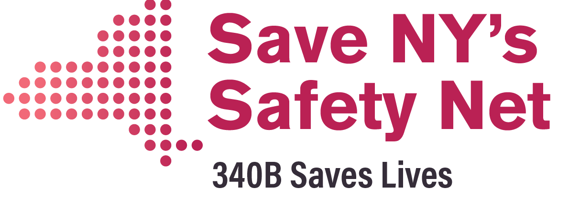
Stakeholder Supported Alternative to the Carve Out
Achieves the State’s Policy Objectives
Averts Disruption
Preserves the Safety Net
Saves Money

Slide 2
S.5136 Achieves Reforms, Keeps the Benefit in Managed Care & Maintains the 340B Mechanism
Improves Patient & Provider Experience
Creates Drug Supply Chain Transparency
Drugs reimbursed at NADAC pricing = objective, transparent & accessible
Ends Restrictive & Anti-Competitive PBM Business Practices
PBMs cannot restrict pharmacies’ access to other pharmacy networks
Enhances State Bargaining Power
Fair and transparent dispensing fees for pharmacies
Reduces Fees to Third Party Middlemen
PBMs cannot mandate use of mail order pharmacies
DOH to set PBM fees to reflect reduced role of PBMs
Reimburse 340B contract pharmacies on a fee basis (vs. % of savings)
Universal Utilization Management Protocols and just one PDL
Single PDL enhances State bargaining power
Increased supplemental rebates
Protects pharmacy choice by ending mail order mandates
Retains managed care plans’ access to real time pharmacy data to resolve access issues at the pharmacy counter

Slide 3


S.5136 / CARVE OUT COMPARISON
DELIVERABLE | S.5136 | CARVE-OUT
Maintains pharmaceutical manufacturer funded 340B discount mechanism
100% of pharmacy discount/rebate remains in NYS*
Sufficient capacity to manage prescription benefit (no hiring additional staff)
Eliminates need for state taxpayer-funded reinvestment pool to 340B CEs
Real time access to pharmacy dispensing data for the managed care plans |  | **
NADAC pricing transparency
Creates drug supply chain transparency
Transparent professional dispensing fee to community pharmacy
Uniform formulary/preferred drug list
State able to leverage purchasing power
Use of PBM for claim data transmission
DOH to set PBM fees to reflect their reduced role
Ends discriminatory & anti-competitive PBM practices
Expanded pharmacy network access
* Percent (%) of discount/ rebate remaining in New York State:
Approximately 70% of state rebates will be sent to federal government
Approximately 30% (1/3) of state rebates will remain in NYS
** Minimum 1 Day Delay

