Slide 1
Making Care Primary (MCP) Model Concept Discussion

Slide 2
MCP Purpose & Goals
This information has not been disclosed to the public, it may be privileged and confidential.

Slide 3

Problem Statement
Primary care forms the foundation of a high-performing health care system
At a time when Medicare and Medicaid beneficiaries most need accessible, affordable, high-quality primary care to meet their rising needs and coordinate their care journey through increasingly fragmented expensive systems, primary care faces existential challenges to its core functions and modes of operation (NASEM 2021).
Office Staff
Behavioral Health Specialist
Social Support Services
PC Clinician
Social Worker
Pharmacist
Medical Assistant
Care Manager
Patient & Family
Home Health Aide
Nurse
Specialists

Slide 4
What will the Making Care Primary (MCP) Model do for Medicare and Medicaid Beneficiaries?
MCP will enable primary care organizations to provide Medicare and Medicaid beneficiaries with integrated, coordinated, person-centered care that achieves improved and equitable population health outcomes on a cost neutral basis over a 10.5-year period.
Behavioral Health Specialist
Social Support Services
PC Clinician
Social Worker
Pharmacist
Nurse
Medical Assistant
Specialists
Patient & Family
Care Manager
Home Health Aide
Office Staff
Community Health Worker

Slide 5
Making Care Primary
State Participation in MCP:
Colorado, Massachusetts, Minnesota, New Mexico, New Jersey, New York, North Carolina, and Washington

Slide 6
Summary of Major Design Features/Policies
This information has not been disclosed to the public, it may be privileged and confidential.

Slide 7
Making Care Primary
Model Overview:
The Making Care Primary (MCP) Model is a 10.5-year multi-payer model:
Three participation tracks that build upon previous primary care models,
MCP aims to improve care for beneficiaries by supporting the delivery of advanced primary care services, which are foundational for a high-performing health system.
The MCP Model will provide a pathway for primary care clinicians with varying levels of experience in value-based care to gradually adopt prospective, population-based payments while building infrastructure to improve behavioral health and specialty integration and drive equitable access to care.
State Medicaid agencies will commit to designing Medicaid programs to align with MCP in key areas.
This model will attempt to strengthen coordination between patients’ primary care clinicians, specialists, social service providers, and behavioral health clinicians, ultimately leading to chronic disease prevention, fewer emergency room visits, and better health outcomes.

Slide 8

MCP’s Progressive, Three-Track Approach
With three tracks that participants can enter upon joining the model, MCP will provide opportunities for organizations across the readiness continuum. Participants can start in any of the 3 tracks. Time in Tracks 1 and 2 are limited to a maximum of 2.5 years, while time in Track 3 is unlimited. Organizations will have an extra 6 months in their starting track due to the proposed midyear model start.
MCP Experience
Track
3
Track
2
Track
1
6.5-10.5 years
2-2.5 years
2.5 years
Infrastructure building
Improving efficiency
Delivering exceptional, accountable care

Slide 9



MCP Care Delivery Domains
MCP care delivery requirements are organized into three domains
Care Management
Education and tools
medication adherence
Care coordination and management
Care Integration
Behavioral health integration
E-consults and specialty integration
Community
Connections
HRSN Screening
Navigating to community supports

Slide 10
Progression of Care Delivery Requirements
Track 1 Care Delivery
- Creating workflows
- Identifying staff
- Identifying specialty care partners
Track 2 Care Delivery
- Service implementation
- Formalizing relationships with specialty care partners
Track 3 Care Delivery
- Workflow optimization
- Service expansion
- Enhanced specialty care referral processes

Slide 11
MCP Quality Performance Measures
Care Management
Care Integration
Community Connections
Care Delivery Domain | Type | Measure | Type | Medicaid Adult Core Measure | Track
 |  |  |  |  | 1 | 2 | 3
 | Chronic Disease Prevention/ Control | Controlling High Blood Pressure* | eCQM | ✓ | X | X | X
 |  | Diabetes Hba1C Poor Control (>9%)* | eCQM | ✓ | X | X | X
 |  | Colorectal Cancer Screening* | eCQM | ✓ | X | X | X
 | Pt. Experience/ PROM | Person-Centered Primary Care Measure (PCPCM) | Survey Vendor |  | X | X | X
 | Behavioral Health | Screening for Depression with Follow Up* | eCQM | ✓ |  | X | X
 |  | Depression Remission within 12 months | eCQM |  |  | X | X
 | Health Equity | Screening for Social Drivers of Health* | TBD |  |  | X | X
 | Cost/ Utilization | Total Per Capita Cost (TPCC) | Claims |  |  | X | X
 |  | Emergency Department Utilization (EDU) | Claims |  |  | X | X
 |  | TPCC Continuous Improvement (CI) (non-health centers) | Claims |  |  | X | X
 |  | EDU CI (health centers) | Claims |  |  | X | X
MCP Is working with CM and CCSQ to encourage participants to optionally report measures included in the final Universal Measure Set.
Examples: Breast Cancer Screening, Adult Immunization Status, Substance Use Disorder Treatment
*indicates alignment with Universal Foundation Measure Set: https://www.nejm.org/doi/full/10.1056/NEJMp2215539

Slide 12
MCP Payment Approach
Payments expressed in PMPM
Bonus
Prospective payment increases over time to support the interprofessional team
Enhanced (guaranteed) investments decrease over time as practices become more advanced
Bonus potential greatly increases over time to make up decreases in guaranteed payments
Bonus
Bonus
Enhanced Investments
Enhanced Investments
Enhanced Investments
Revenue potential
Fee-for-Service
Prospective payment
Prospective payment
Fee-for-Service
Track 1
Track 2
Track 3

Slide 13
Payment Deep Dive– Performance Incentive Payment
Bonus
The Performance Incentive Payment rewards practices for performance on MCP Quality measures
Success on each measure contributes to a participants overall performance incentive
Maximum potential incentive payments by Track:
Track 1: 3% of Total Medicare FFS Primary Care Payments
Track 2: 45% of Sum of Medicare FFS Primary Care Payments and Prospective Payment for Services
Track 3: 60% of Sum of Medicare FFS Primary Care Payments and Prospective Payment for Services
Potential incentive payment increases to offset decrease in Enhanced Service Payments by track – to gradually move participants from earning majority of revenue from FFS to VBP.

Slide 14










Summary of Health Equity Approach
CMS Framework for Operationalizing Health Equity
CMS Framework Priority | MCP Policies
Expand the Collection, Reporting, and Analysis of Standardized Data | Require participants to implement HRSN screening Collect beneficiary-level demographic and HRSN data and integrate into tools to support practices in tailoring care to their populations
Evaluate Disparities Impacts and Integrate Equity Solutions across CMS Programs | Reward participants for screening for social determinants Assess MCP’s impact on social drivers of health in the evaluation
Build Capacity of Healthcare Organizations and the Workforce to Reduce Health Care Disparities | Provide more financial resources to practices serving underserved populations
Advance Language Access, Health Literacy and the Provision of Culturally Tailored Services | Require participants to implement and improve upon Health Equity plans Improve chronic disease self-management through education
Increase All Forms of Accessibility to Health Care Services & Coverage | Waive coinsurance for certain high-need beneficiaries

Slide 15
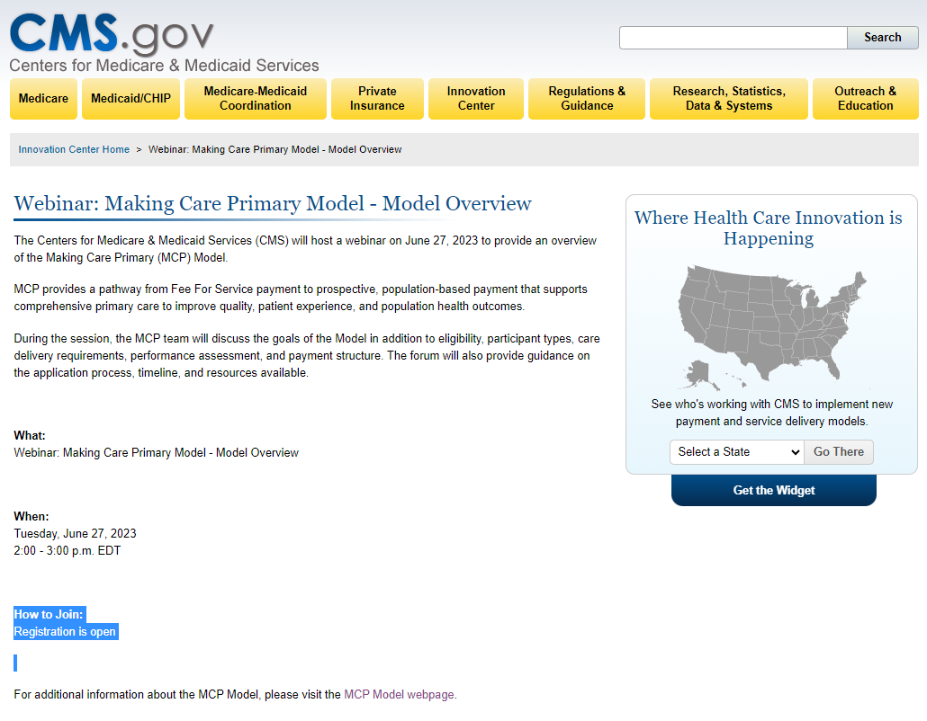

Slide 16
Thank you!
Questions?

